Slide 1
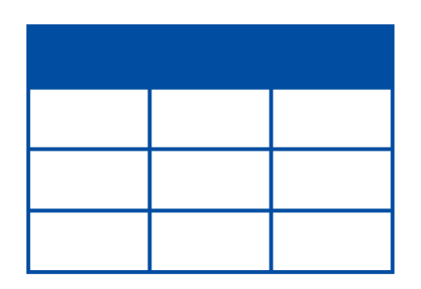



Data Visualization Process
Too simple?
Use a snapshot of
the chart in report
Single file contains data
Create a chart

Slide 2
Data Visualization Process
Data is in multiple files
Data is in different types of files
Practical challenges
Data is getting dynamically updated
Ability to create all popular charts
Ability to customize charts as required
Ability to draw multiple charts and create dashboards

Slide 3
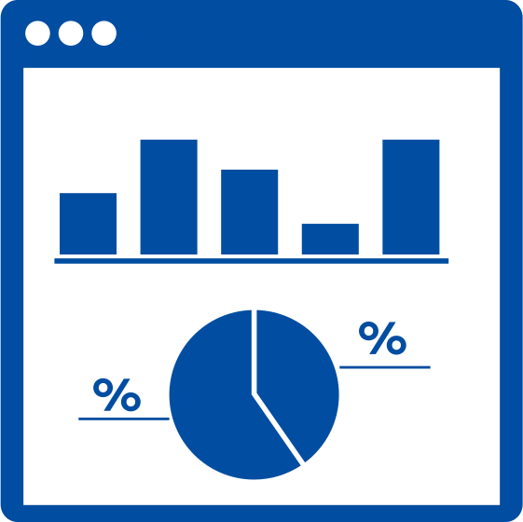
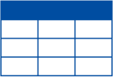

Data Visualization Process
Practical challenges
Multiple data sources
Steps
Connect with data sources
Collate and prepare data
Draw all types of charts
Customize the charts
Dynamic & Interactive dashboard
Share, Embed & View
Collaborate

Slide 4
Tableau Products
Tableau Desktop
Tableau Desktop
Tableau Prep
1. Windows/ Mac application for PC
2. The mail visualization tool by Tableau
Tableau Server
3. Can connect with Tableau Online/ Tableau Public for collaboration with
Tableau Online
team members
Tableau Public

Slide 5
Tableau Products
Tableau Prep
Tableau Desktop
Tableau Prep
1. Used for preprocessing the data
2. Does data cleaning/ validation and integration using a visual interface
Tableau Server
3. Tableau desktop creator license grants access to Tableau Prep also
Tableau Online
Tableau Public

Slide 6




Tableau Products
Tableau Server/ Tableau Online
Used for connecting and collaborating with team members
Tableau Desktop
Tableau Prep
Tableau server will be installed on company server
Tableau Server
Tableau Desktop will talk with Tableau server via Intranet
Tableau Online
Individuals will be using Tableau Desktop on their PC
Tableau Public

Slide 7


Tableau Products
Tableau Server/ Tableau Online
Used for connecting and collaborating with team members
Tableau Desktop
Tableau Prep
Tableau online is hosted and managed by Tableau
Tableau Server
Tableau Desktop will talk with Tableau Online via Internet
Tableau Online
Tableau Public

Slide 8
Tableau Products
Tableau Public
Tableau Desktop
Tableau Prep
1. Hosted by Tableau – free for all to use
2. Your work will be open for anyone to see
Tableau Server
3. Web based application
Tableau Online
Tableau Public

Slide 9
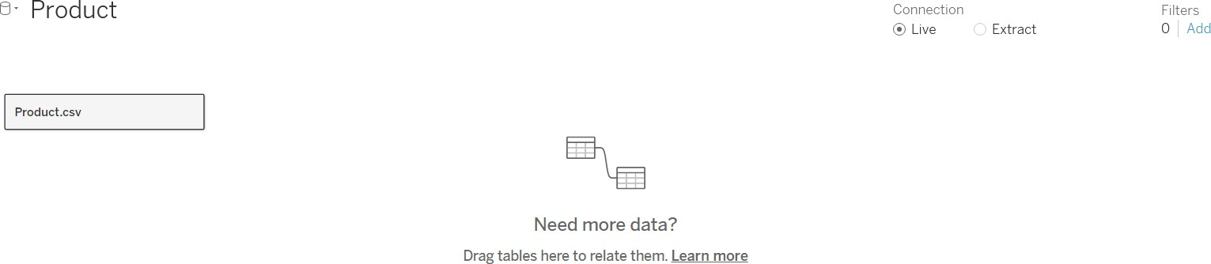



Live vs Extract Connection
Real time updates
Better performance
Data Source
Visualizations
Data Source
Snapshot of data
Extract
Visualizations
Live connection
Whenever any change is made, data is
fetched from the data source
Extract
Whenever any change is made, data is fetched from the snapshot (Extract)
Visualizations are updated in real-time
Extracts need to be are updated for any
update in data

Slide 10
Joining data from multiple tables
Sales Table
Sales values only
Order Line | Order ID | Order Date | Ship Date | Ship Mode |  |  | Customer ID | Product ID |  | Sales | Quantity | Discount | Profit
1 | CA-2016-152156 | 08-11-2016 | 11-11-2016 | Second Clas | s |  | CG-12520 | FU | R-BO-10001798 | 261.96 | 2 | 0 | 41.9136
2 | CA-2016-152156 | 08-11-2016 | 11-11-2016 | Second Class |  |  | CG-12520 | FUR-CH-10000454 |  | 731.94 | 3 | 0 | 219.582
3 | CA-2016-138688 | 12-06-2016 | 16-06-2016 | Second Class |  |  | DV-13045 | OFF-LA-10000240 |  | 14.62 | 2 | 0 | 6.8714
4 | US-2015-108966 | 11-10-2015 | 18-10-2015 | Standard Class |  |  | SO-20335 | FUR-TA-10000577 |  | 957.5775 | 5 | 0.45 | -383.031
5 | US-2015-108966 | 11-10-2015 | 18-10-2015 | Standard Class |  |  | SO-20335 | OFF-ST-10000760 |  | 22.368 | 2 | 0.2 | 2.5164
Scenario 1: Joining two different tables
Customer Table
Region values only
Customer ID | Customer Name | Segment | Age | Country | City | State | Postal Code | Region
CG-12520 | Claire Gute | Consumer | 67 | United States | Henderson | Kentucky | 42420 | South
DV-13045 | Darrin Van Huff | Corporate | 31 | United States | Los Angeles | California | 90036 | West
SO-20335 | Sean O'Donnell | Consumer | 65 | United States | Fort Lauderdale | Florida | 33311 | South
BH-11710 | Brosina Hoffman | Consumer | 20 | United States | Los Angeles | California | 90032 | West

Slide 11
3 ways of joining data in tableau
Later
Blending
Joining
Relationships
New way of joining data in
Tableau

Slide 12
Merging data from multiple tables
Combining similar data using operators like Union, Intersect and Except
Customer ID | Customer Name | Segment | Age | Country | City | State | Postal Code | Region
EB-13870 | Emily Burns | Consumer | 34 | United States | Orem | Utah | 84057 | West | Online customers
EH-13945 | Eric Hoffmann | Consumer | 21 | United States | Los Angeles | California | 90049 | West
TB-21520 | Tracy Blumstein | Consumer | 48 | United States | Philadelphia | Pennsylvania | 19140 | East
MA-17560 | Matt Abelman | Home Office | 19 | United States | Houston | Texas | 77095 | Central
Scenario 2: Merging similar tables
Customer ID | Customer Name | Segment | Age | Country | City | State | Postal Code | Region
ON-18715 | Odella Nelson | Corporate | 27 | United States | Eagan | Minnesota | 55122 | Central | Offline customers
PO-18865 | Patrick O'Donnell | Consumer | 64 | United States | Westland | Michigan | 48185 | Central
LH-16900 | Lena Hernandez | Consumer | 66 | United States | Dover | Delaware | 19901 | East
Customer ID | Customer Name | Segment | Age | Country | City | State | Postal Code | Region
EB-13870 | Emily Burns | Consumer | 34 | United States | Orem | Utah | 84057 | West
EH-13945 | Eric Hoffmann | Consumer | 21 | United States | Los Angeles | California | 90049 | West
TB-21520 | Tracy Blumstein | Consumer | 48 | United States | Philadelphia | Pennsylvania | 19140 | East
MA-17560 | Matt Abelman | Home Office | 19 | United States | Houston | Texas | 77095 | Central
ON-18715 | Odella Nelson | Corporate | 27 | United States | Eagan | Minnesota | 55122 | Central
PO-18865 | Patrick O'Donnell | Consumer | 64 | United States | Westland | Michigan | 48185 | Central
LH-16900 | Lena Hernandez | Consumer | 66 | United States | Dover | Delaware | 19901 | East

Slide 13
Merging data from multiple tables
Combining similar data using operators like Union, Intersect and Except
Presentations are communication tools that can be used as demonstrations, lectures, speeches, reports, and more. It serves a variety of purposes, making presentations powerful tools for convincing and teaching.
Number | Product | Quantity | Unit cost | Total cost
01 | Product 1 | 156 | piece | 1000
02 | Product 2 | 345 | piece | 2000
03 | Product 3 | 554 | piece | 5000
04 | Product 4 | 888 | piece | 6000

Slide 14
Joins
To join tables we must know:
The names of the tables to be joined
The common column based on which we will join them
The list of columns from each table
What’s needed
Order Line | Order ID | Order Date | Ship Date | Ship Mode | Customer ID | Product ID | Sales | Quantity | Discount | Profit
1 | CA-2016-152156 | 08-11-2016 | 11-11-2016 | Second Class | CG-12520 | FUR-BO-10001798 | 261.96 | 2 | 0 | 41.9136
2 | CA-2016-152156 | 08-11-2016 | 11-11-2016 | Second Class | CG-12520 | FUR-CH-10000454 | 731.94 | 3 | 0 | 219.582
3 | CA-2016-138688 | 12-06-2016 | 16-06-2016 | Second Class | DV-13045 | OFF-LA-10000240 | 14.62 | 2 | 0 | 6.8714
4 | US-2015-108966 | 11-10-2015 | 18-10-2015 | Standard Class | SO-20335 | FUR-TA-10000577 | 957.5775 | 5 | 0.45 | -383.031
5 | US-2015-108966 | 11-10-2015 | 18-10-2015 | Standard Class | SO-20335 | OFF-ST-10000760 | 22.368 | 2 | 0.2 | 2.5164
Customer ID | Customer Name | Segment | Age | Country | City | State | Postal Code | Region
CG-12520 | Claire Gute | Consumer | 67 | United States | Henderson | Kentucky | 42420 | South
DV-13045 | Darrin Van Huff | Corporate | 31 | United States | Los Angeles | California | 90036 | West
SO-20335 | Sean O'Donnell | Consumer | 65 | United States | Fort Lauderdale | Florida | 33311 | South
BH-11710 | Brosina Hoffman | Consumer | 20 | United States | Los Angeles | California | 90032 | West

Slide 15
Relationship – performance options
Customer table
Postal code master table
Customer ID | Postal code
CG-12520 | 42420
DV-13045 | 90036
SO-20335 | 33311
BH-11710 | 90036
Postal code | City | State | Region
32303 | Tallahassee | Florida | South
32725 | Deltona | Florida | South
32935 | Melbourne | Florida | South
33012 | Hialeah | Florida | South
33311 | Fort Lauderdale | Florida | South
. | . | . | .
. | . | . | .
Cardinality
Are postal code values unique in this table?
Are postal code values unique in this table?
Not unique -> ‘Many’
Unique -> ‘One’
‘Many to One’
We are joining customer table with postal code master - postal code is the matching key

Slide 16
Relationship – performance options
Customer table
Reference table
Customer ID | Postal code
CG-12520 | 42420
DV-13045 | 90036
SO-20335 | 33311
BH-11710 | 90036
Customer ID | Ref Name | Ref Contact
CG-12520 | Cindy Stewart | 10897310
CM-11935 | Dan Campbell | 16589278
CM-12385 | Darren Koutras | 95721837
CG-12520 | Denny Ordway | 16507437
CS-12355 | Evan Bailliet | 76772276
CS-12460 | Erica Hackney | 69524187
Cardinality
Is customer ID unique in this table?
Is customer ID unique in this table?
Unique -> ‘One’
Not unique -> ‘Many’
‘One to Many’
We are joining customer table with reference table – customer ID is the matching key

Slide 17
Relationship – performance options
‘Many to Many’ is the default setting in Tableau
It will not give wrong visualizations
Cardinality
We can improve performance slightly if we specify the exact cardinality
Change only if you know what you are doing

Slide 18
Relationship – performance options
Customer table
Reference table
Customer ID | Postal code
CG-12520 | 42420
DV-13045 | 90036
SO-20335 | 33311
BH-11710 | 90036
Customer ID | Ref Name | Ref Contact
CG-12520 | Cindy Stewart | 10897310
CM-11935 | Dan Campbell | 16589278
CM-12385 | Darren Koutras | 95721837
CG-12520 | Denny Ordway | 16507437
CS-12355 | Evan Bailliet | 76772276
CS-12460 | Erica Hackney | 69524187
Referential Integrity
Are all customer IDs in customer table also present in the reference table?
Are all customer IDs in reference table also present in the customer table?
No -> ‘Some records match’
Yes -> ‘All records match’
We are joining customer table with reference table – customer ID is the matching key

Slide 19
Relationship – performance options
‘Some records match’ is the default setting in Tableau
It will not give wrong visualizations
Referential Integrity
We can improve performance if we specify the exact referential integrity
Change only if you know what you are doing

Slide 20
Physical vs Logical layer
Observations
Physical Layer
We can do Join and Union here
Result of joining and union is a single table
Logical Layer
Single logical table can have multiple
joined and Union tables
Relationships can be defined – ‘Noodles
Related tables remain individual tables

Slide 21

Physical vs Logical layer
Data Model - Example
Logical Layer
Sales and Customer joined data | Relationship | Product Master – Union of all product tables
Union
Join
Union
Sales Table
Customer Table
Online Products Table
Physical Layer
Offline Products Table
Archived Products Table

Slide 22
Physical vs Logical layer
Data Model
Logical Layer
Relationships
Product table
Sales data
Customer table
Physical Layer
Sales Table
Union
Bug sales Table

Slide 23
Types of Data in Tableau
Student ID | Gender | Age | Hours studied | Marks scored | Year of exam
S101 | Male | 19 | 18 | 73 | 2021
S102 | Female | 20 | 15 | 85 | 2020
S103 | Female | 16 | 21 | 71 | 2023
S104 | Male | 19 | 23 | 89 | 2022
S105 | Female | 19 | 25 | 94 | 2022
S106 | Female | 20 | 27 | 70 | 2020
S107 | Male | 21 | 15 | 95 | 2019
S108 | Male | 21 | 20 | 70 | 2021
S109 | Female | 16 | 17 | 79 | 2019
S110 | Female | 18 | 26 | 73 | 2020
… | … | … | … | … | …
Dimensions vs measures
Dimensions are columns containing categories/ segments based on which aggregation will be done
Measures are numeric columns for which we wish to get the aggregate values
Gender | Sum of Hours studied
Female | 131
Male | 76
Year of Exam | Average of Marks scored
2019 | 87
2020 | 76
2021 | 71.5
2022 | 91.5
2023 | 71
Sum, Average, Min, Max, count are some aggregate functions

Slide 24
Types of Data in Tableau
Student ID | Gender | Age | Hours studied | Marks scored | Year of exam
S101 | Male | 19 | 18 | 73 | 2021
S102 | Female | 20 | 15 | 85 | 2020
S103 | Female | 16 | 21 | 71 | 2023
S104 | Male | 19 | 23 | 89 | 2022
S105 | Female | 19 | 25 | 94 | 2022
S106 | Female | 20 | 27 | 70 | 2020
S107 | Male | 21 | 15 | 95 | 2019
S108 | Male | 21 | 20 | 70 | 2021
S109 | Female | 16 | 17 | 79 | 2019
S110 | Female | 18 | 26 | 73 | 2020
… | … | … | … | … | …
Dimensions vs measures
Same column can act as a dimension in some scenarios and as a measure in other scenarios
Age | Average of Hours studied
16 | 19
18 | 26
19 | 22
20 | 21
21 | 17.5
Gender | Average of Age
Female | 18.2
Male | 20

Slide 25
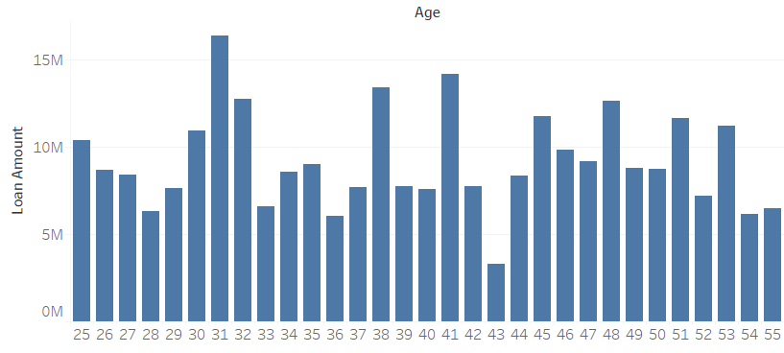
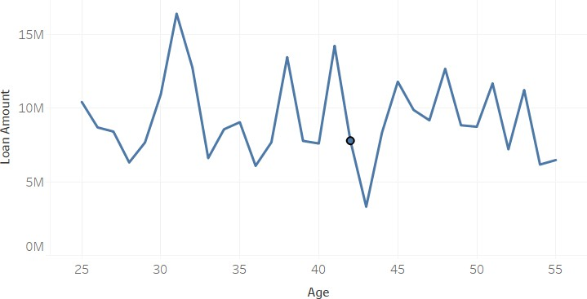
Types of Data in Tableau
Discrete vs continuous
Discrete - A set of finite values
  Will add headers on the axes
Continuous – Infinite range
  Will add infinite range on the axes
Age is set as discrete
Age is set as continuous

Slide 26
Types of Data in Tableau
 | Discrete (Blue) Finite – adds headers | Continuous (Green) Infinite range – adds axes
Dimension String, date, numeric | Eg. - Name, Gender, category, etc. Common | Eg. Year(transaction date) Rare
Measure Numeric - aggregation | Eg. Sum(profit) Rare | Eg. Sum(profit), Average(age) Common

Slide 27
Binning data
Converting continuous numeric data into bins/ groups
Age
18
19
:
:
39
40
41
:
: 64
65
66
:
:
Young
Bins
Middle Aged
Seniors

Slide 28
Grouping data
Clubbing similar categories together into groups
Sub-categories
Phones Accessories
Phones & Acc.
Accessories Appliances Bookcases Chairs Copiers Envelopes Furnishings Labels Machines Paper Phones Storage Tables
Tables Chairs
Tables & Chairs
Groups
Appliances Bookcases Copiers Envelopes Furnishings Labels Machines Paper Storage
Others

Slide 29
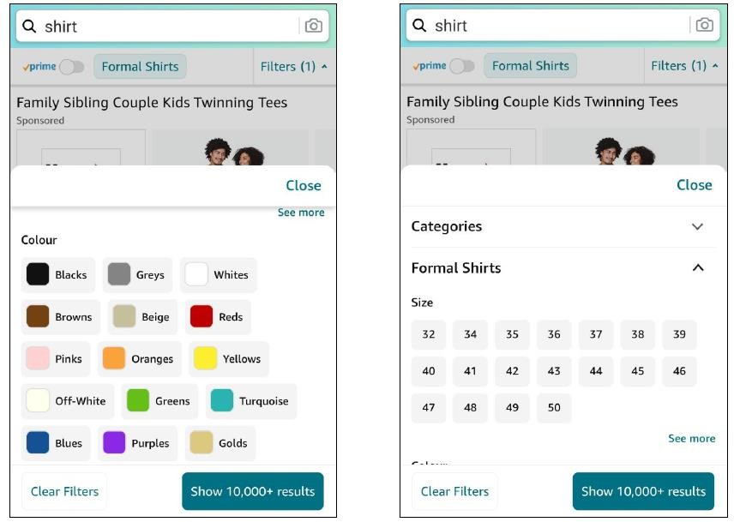
Filtering
Showing only relevant data/ hiding irrelevant information
Examples

Slide 30
Filters
Order of operation is the order in which different types of filters are
executed in Tableau
In Tableau, filters are executed in the following order:
Order of operation
Extract filters
Data source filters
Context filters
Filters on dimensions
Filters on measures
Order of execution is important because it can impact the final output and the performance when multiple filters are applied

Slide 31


Filters
Output of two dimension filters
Calculation
Steps
Two filters
Output of filter 1 – Apple, Strawberry and Watermelon
Filter 1 checks 10 fruits
Filter 1 – Only red fruits (inside or outside)
Filter 2 checks 10 fruits
Output of filter 2 – Watermelon and
melon
Filter 2 – Top 2 fruits by weight
Common/ intersection of two results is shown finally
Final output – Only Watermelon

Slide 32
Filters
Output of one context and one dimension filter
Calculation
Steps
Two filters
Output of filter 1 – Apple, Strawberry and Watermelon
Filter 1 checks 10 fruits
Filter 1
(Set as context filter)
–
Only red fruits (inside or outside)
Filter 2 checks 3 fruits only
Output of filter 2 – Watermelon and
Apple
Less calculation
Filter 2 – Top 2 fruits by weight
Result of filter 2 is final result
Final output – Watermelon and Apple
Different Result

Slide 33
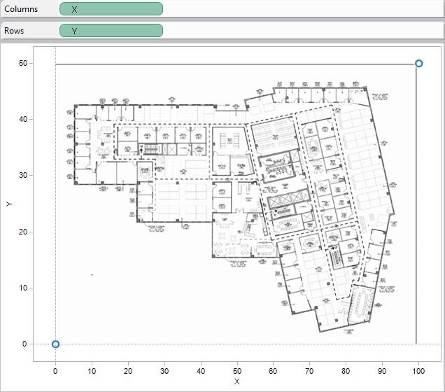
Maps
To plot data points on custom background images
Custom background image

Slide 34
Maps
To plot data points on custom background images

Slide 35
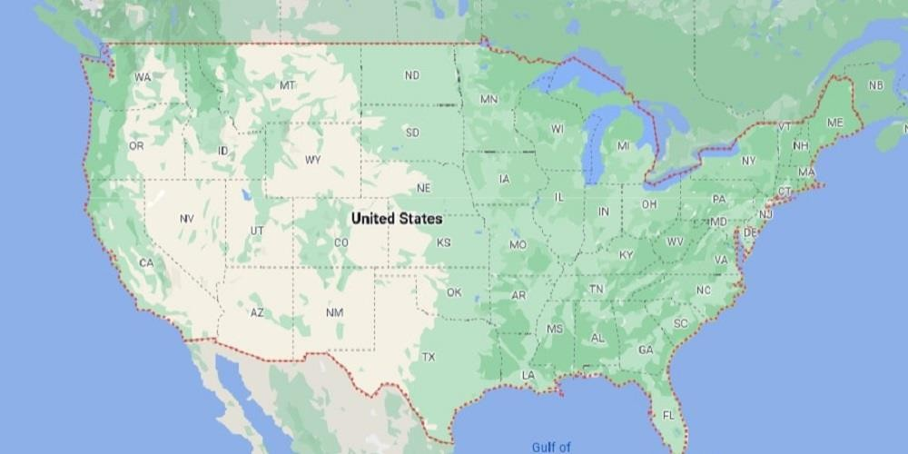
Maps
50
45
40
35
30
Custom background image
25
20
15
10
5
0
0
10
20
30
40
50
60
70
80
90
100
State | X coordinate | Y coordinate
California | 13 | 26
New York | 84 | 34
Texas | 50 | 10

Slide 36
Maps
Territory | States
Territory 1 | California, Texas, New York
Territory 2 | Washington, Pennsylvania, Illinois
Territory 3 | All other states
Territories

Slide 37
Blending for missing geocoding
Joining
Blending
Relationships
Blending is used when the data tables are present in different data sources

Slide 38
Data Analysis
Predefined formulas to do a specific calculation
Types of functions:
Number functions
Date functions
Text functions
Logical functions
Aggregate functions
Functions
Documentation - https://help.tableau.com/current/pro/desktop/en- us/functions_all_categories.htm
Task – Create the same calculated field (as in last class) using CASE WHEN function

Slide 39
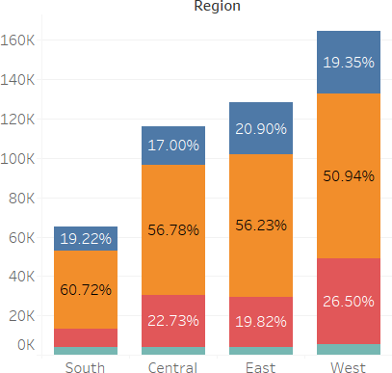
Data Analysis
Table calculations – Calculations on plotted data
Table Calculations

Slide 40


Data Analysis
Table calculations only consider the final data plotted for calculations
Table Calculations
Final data which is plotted
The complete data

Slide 41
Data Analysis
Table calculations have two parts – Calculation and Direction
Types of calculations – Differences, percentages, ranks etc.
Direction – Across the table, Down the table, down and across etc.
Table Calculations
 | Marketing | Finance | HR | Total
Salaries | 200 | 300 | 100 | 600
Agency payments | 500 | 100 | 500 | 1100
Other expenses | 300 | 100 | 200 | 600
Total | 1000 | 500 | 800 | 2300

Slide 42
Data Analysis
Table calculations have two parts – Calculation and Direction
Marketing Finance HR Total
200 300 100 600
This total will
Salaries
Agency payments | 500 | ₁₀₀ Across | 500
Other expenses | 300 | 100 | 200
Total | 1000 | 500 | 800
1100
600
Table Calculations
be used
2300
 | Marketing | Finance | HR | Total
Salaries | 33% | 50% | 17% | 100%
Agency payments | 45% | 10% | 45% | 100%
Other expenses | 50% | 17% | 33% | 100%

Slide 43
Data Analysis
Table calculations have two parts – Calculation and Direction
Marketing
Finance
HR
Total
Salaries
200
300
100
600
Agency payments
500
Down
500
1100
100
Table Calculations
Other expenses 300
100
200
600
To
This total will
1000
500
800
2300
tal
be used
 | Marketing | Finance | HR
Salaries | 20% | 60% | 12.5%
Agency payments | 50% | 20% | 62.5%
Other expenses | 30% | 20% | 25%
Total | 100% | 100% | 100%

Slide 44
Data Analysis
Table calculations have two parts – Calculation and Direction
 | Marketing | Finance | HR |  | Total
Salaries | 200 | 300 | 100 |  | 600
Agency payments | 500 | 100 | 500 |  | 1100
Other expenses | 300 | 100 | 200 |  | 600
Total | 1000 | 500 |  | This total will | 2300
 |  |  |  | be used
Table Calculations
800
 | Marketing | Finance | HR
Salaries | 9% | 13% | 4%
Agency payments | 22% | 4% | 22%
Other expenses | 13% | 4% | 9%

Slide 45
Sets
A subset of data based on some conditions
What
List of all states
States with more than 50
customers/ employees

Slide 46
Sets
Sets are created based on a condition
Why
OUT
IN
Either select manually or Specify a condition,
If true – that element is part of Set A or the IN set
If False – that element is part of Set B or the OUT set

Slide 47
Sets
Sets can be used to compare IN vs OUT performance
Why
OUT
IN
Example: Compare the sum of sales in top 3 states vs all other states
IN – Top 3 states
OUT – All other states

Slide 48
Sets
Sets can be used combine sets as per set theory
Why
Customers who made a purchase in 2020
Customers who made a purchase in 2021
Customers who made a purchase in both, 2020 and 2021

Slide 49
Sets
Sets can be used combine sets as per set theory
Why
Union – All members in both sets
Intersect – Shared members in both sets
Except – members in one set except other set

Slide 50
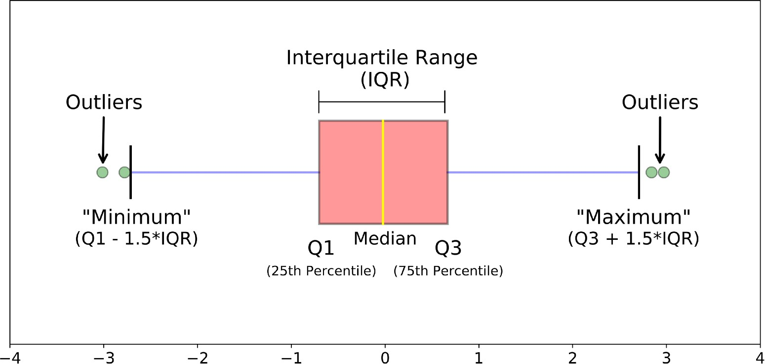
Box plot
What

Slide 51
Level of Detail
Level of Detail is the granularity in data/ how fine is the information
Student | Exam Subject | Institute | Marks Scored
Student 1 | Math | A | 92
Student 2 | Science | A | 73
Student 3 | English | A | 86
Student 4 | Math | A | 66
Student 5 | Science | A | 52
Student 6 | English | A | 100
Student 7 | Math | B | 86
Student 8 | Science | B | 51
Student 9 | English | B | 99
Student 10 | Math | B | 67
Student 11 | Science | B | 81
Student 12 | English | B | 54
Subject | Institute A | Institute B
English | 93.0 | 76.5
Math | 79.0 | 76.5
Science | 62.5 | 66.0
What
2 * 3 = 6 marks - less level of detail
Subject | Average Marks Scored
English | 84.8
Math | 77.8
Science | 64.3
1 * 3 = 3 marks - lesser level of detail
Original table – has 3 * 12 = 36 marks Very high level of detail
1 mark - least level of detail
Average of Marks Scored
75.6

Slide 52
LOD expressions
Level of Detail expressions help in specifying the level of detail for aggregation of a calculated field
Usually aggregation happens at visualization level
With LOD expressions, we can control the level of detail of the aggregation
What & Why
Syntax – { LOD keyword Dimension(s) : Aggregate Calculation }
Example: { FIXED [segment] : SUM([profit]) }
There are three LOD keywords:
FIXED
INCLUDE
EXCLUDE

Slide 53
LOD expressions
Example
{ FIXED [Student]: SUM([Marks Scored]) }
Student | Exam Subject | Institute | Marks Scored
Student 1 | Math | A | 92
Student 1 | Science | A | 73
Student 1 | English | A | 86
Student 2 | Math | A | 66
Student 2 | Science | A | 52
Student 2 | English | A | 100
Student 3 | Math | B | 86
Student 3 | Science | B | 51
Student 3 | English | B | 99
Student 4 | Math | B | 67
Student 4 | Science | B | 81
Student 4 | English | B | 54
Student | Exam Subject | Institute | Marks Scored | FIXED LOD
Student 1 | Math | A | 92 | 251
Student 1 | Science | A | 73 | 251
Student 1 | English | A | 86 | 251
Student 2 | Math | A | 66 | 218
Student 2 | Science | A | 52 | 218
Student 2 | English | A | 100 | 218
Student 3 | Math | B | 86 | 236
Student 3 | Science | B | 51 | 236
Student 3 | English | B | 99 | 236
Student 4 | Math | B | 67 | 202
Student 4 | Science | B | 81 | 202
Student 4 | English | B | 54 | 202
Students | Sum of Marks Scored
Student 1 | 251
Student 2 | 218
Student 3 | 236
Student 4 | 202
Compare: AVG(marks scored) on institute dimension vs AVG(FIXED LOD) on institute dimension

Slide 54
LOD expressions
Example
{ Include [Student]: SUM([Marks Scored]) }
Student | Exam Subject | Institute | Marks Scored
Student 1 | Math | A | 92
Student 1 | Science | A | 73
Student 1 | English | A | 86
Student 2 | Math | A | 66
Student 2 | Science | A | 52
Student 2 | English | A | 100
Student 3 | Math | B | 86
Student 3 | Science | B | 51
Student 3 | English | B | 99
Student 4 | Math | B | 67
Student 4 | Science | B | 81
Student 4 | English | B | 54
Student | Exam Subject | Institute | Marks Scored | Include
Student 1 | Math | A | 92 | 251
Student 1 | Science | A | 73 | 251
Student 1 | English | A | 86 | 251
Student 2 | Math | A | 66 | 218
Student 2 | Science | A | 52 | 218
Student 2 | English | A | 100 | 218
Student 3 | Math | B | 86 | 236
Student 3 | Science | B | 51 | 236
Student 3 | English | B | 99 | 236
Student 4 | Math | B | 67 | 202
Student 4 | Science | B | 81 | 202
Student 4 | English | B | 54 | 202
Students | Sum of Marks Scored
Student 1 | 251
Student 2 | 218
Student 3 | 236
Student 4 | 202
Compare: AVG(marks scored) on institute dimension vs AVG(Include) on institute dimension Compare: AVG(Fixed LOD) on Subject dimension vs AVG(Include) on subject dimension

Slide 55
LOD expressions
Example
{ Exclude [Student]: SUM([Marks Scored]) }
Student | Exam Subject | Institute | Marks Scored
Student 1 | Math | A | 92
Student 1 | Science | A | 73
Student 1 | English | A | 86
Student 2 | Math | A | 66
Student 2 | Science | A | 52
Student 2 | English | A | 100
Student 3 | Math | B | 86
Student 3 | Science | B | 51
Student 3 | English | B | 99
Student 4 | Math | B | 67
Student 4 | Science | B | 81
Student 4 | English | B | 54
Aggregation depends on Visualization LOD
Student field will be excluded
while aggregating
Students | Sum of Marks Scored
Student 1 | 907
Student 2 | 907
Student 3 | 907
Student 4 | 907
Compare: AVG(marks scored) vs AVG(Include) on institute dimension
Compare: AVG(Fixed LOD) on Subject dimension vs AVG(Include) on subject dimension

